Slide 1
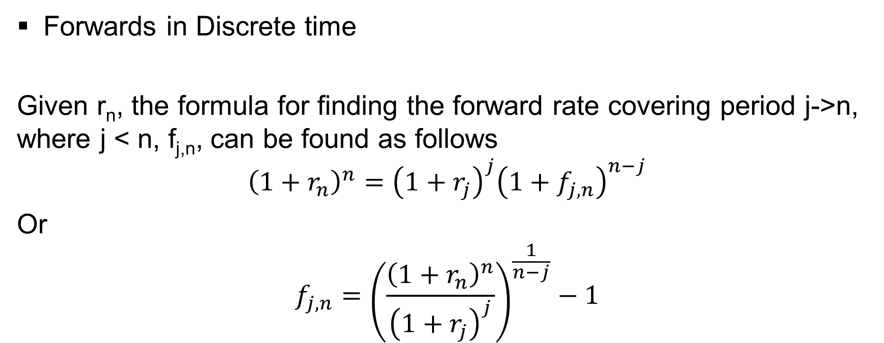
Some Basic Gymnastics
Forwards in Discrete time
Given r_{n}, the formula for finding the forward rate covering period j->n, where j < n, f_{j,n}, can be found as follows
$${\left(1+r_{n}\right)}^{n}={\left(1+r_{j}\right)}^{j}{\left(1+f_{j,n}\right)}^{n−j}$$
Or
$$f_{j,n}={\left(\frac{{\left(1+r_{n}\right)}^{n}}{{\left(1+r_{j}\right)}^{j}}\right)}^{\frac{1}{n−j}}−1$$

Slide 2
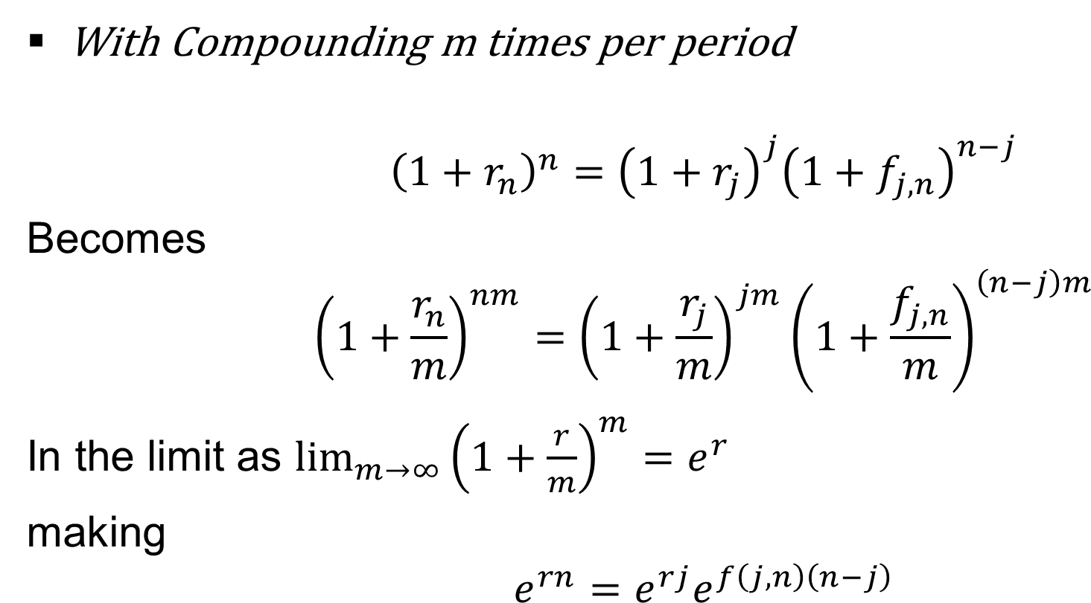
Some Basic Gymnastics - 2
With Compounding m times per period
$${\left(1+r_{n}\right)}^{n}={\left(1+r_{j}\right)}^{j}{\left(1+f_{j,n}\right)}^{n−j}$$
Becomes
$${\left(1+\frac{r_{n}}{m}\right)}^{nm}={\left(1+\frac{r_{j}}{m}\right)}^{jm}{\left(1+\frac{f_{j,n}}{m}\right)}^{\left(n−j\right)m}$$
In the limit as $\lim_{m→∞}{{\left(1+\frac{r}{m}\right)}^{m}}=e^{r}$
making
$$e^{rn}=e^{rj}e^{f\left(j,n\right)\left(n−j\right)}$$

